Slide 1
Textbox , Label & Button Tools in VB.NET
Prof. Neeraj Bhargava
Kapil Chauhan
Department of Computer Science
School of Engineering & Systems Sciences
MDS University, Ajmer

Slide 2
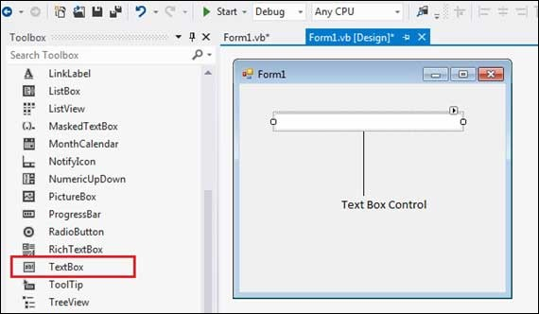
VB.Net - TextBox Control
Text box controls allow entering text on a form at runtime. By default, it takes a single line of text, however, you can make it accept multiple texts and even add scroll bars to it.

Slide 3
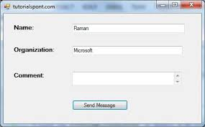
TextBox Control
VB.Net programmers make extensive use of the TextBox control to let the user view or enter large amount of text.
A text box object is used to display text on a form or to get user input while a VB.Net program is running.
In a text box, a user can type data or paste it into the control from the clipboard.

Slide 4
The Properties of the TextBox Control
Sr.No. | Property & Description
1 | AcceptsReturn Gets or sets a value indicating whether pressing ENTER in a multiline TextBox control creates a new line of text in the control or activates the default button for the form.
2 | AutoCompleteMode Gets or sets an option that controls how automatic completion works for the TextBox.
3 | AutoCompleteSource Gets or sets a value specifying the source of complete strings used for automatic completion.
4 | Font Gets or sets the font of the text displayed by the control.

Slide 5
The Methods of the TextBox Control
Sr.No. | Method Name & Description
1 | AppendText Appends text to the current text of a text box.
2 | Clear Clears all text from the text box control.
3 | Copy Copies the current selection in the text box to the Clipboard
4 | Cut Moves the current selection in the text box to the Clipboard

Slide 6
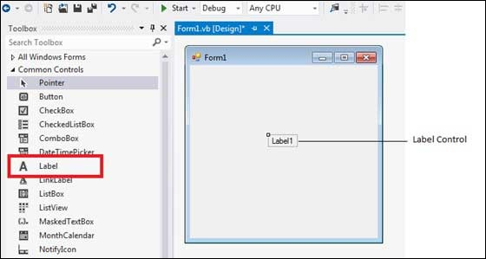
VB.Net - Label Control

Slide 7
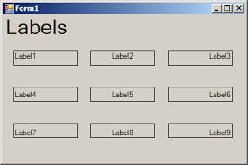
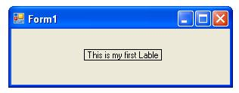
The Label control represents a standard Windows label.
It is generally used to display some informative text on the GUI which is not changed duringruntime.

Slide 8
Properties of the Label Control
Sr.No. | Property & Description
1 | Autosize Gets or sets a value specifying if the control should be automatically resized to display all its contents.
2 | BorderStyle Gets or sets the border style for the control
3 | FlatStyle Gets or sets the flat style appearance of the Label control
4 | Font Gets or sets the font of the text displayed by the control.

Slide 9
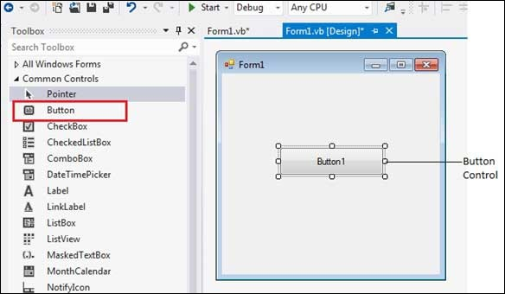
VB.Net - Button Control
The Button control represents a standard Windows button.
It is generally used to generate a Click event by providing a handler for the Click event.

Slide 10
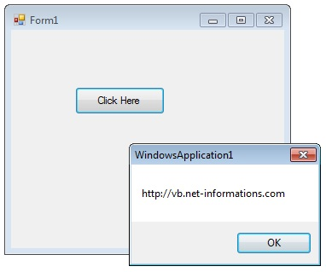
A Button is a control, which is an interactive component that enables users to communicate with an application which we click and release to perform some actions.

Slide 11
Assignment Question
Q1.Explain the following tools with suitable example
(i) Button
(ii) Label
(iii) TextBox

